Slide 1
For whom the bells tolls….
St Marys University
Belfast 13/5/25

Slide 2
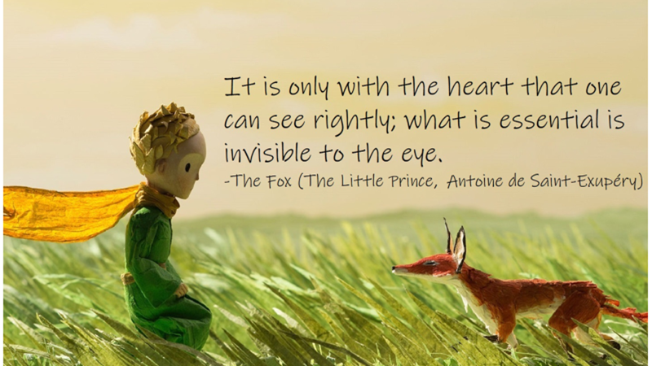

Slide 4
“Child Of our time, our times have robbed your cradle. Sleep in a world your final sleep has woken.”
Eavan Boland

Slide 5
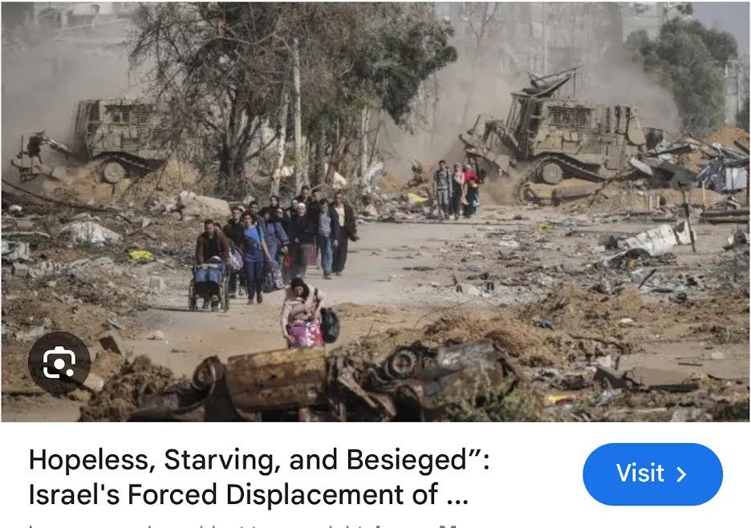

Slide 8
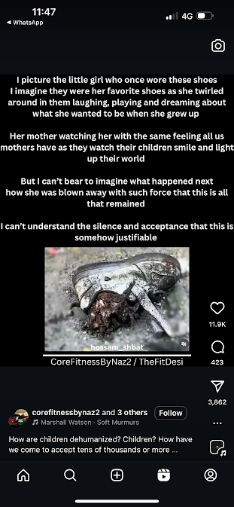

Slide 9
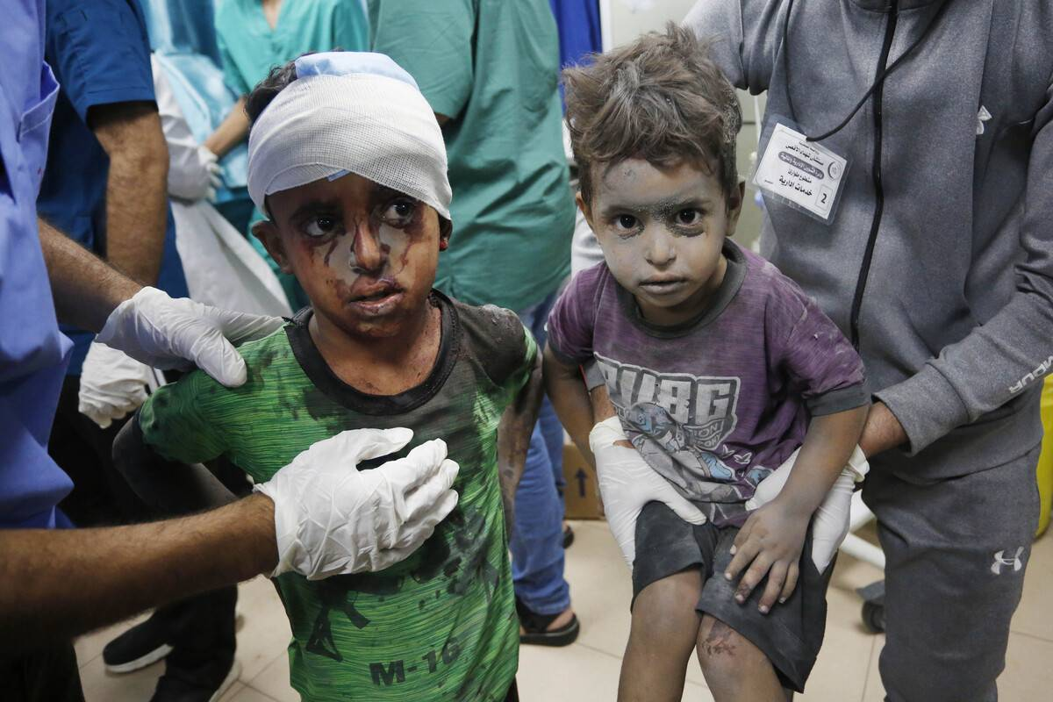

Slide 10
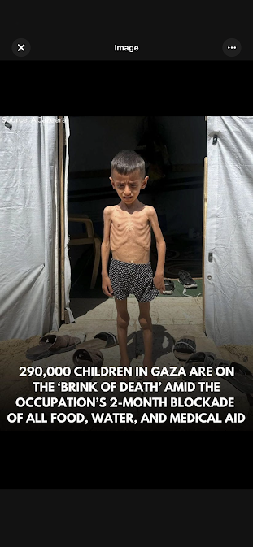

Slide 11
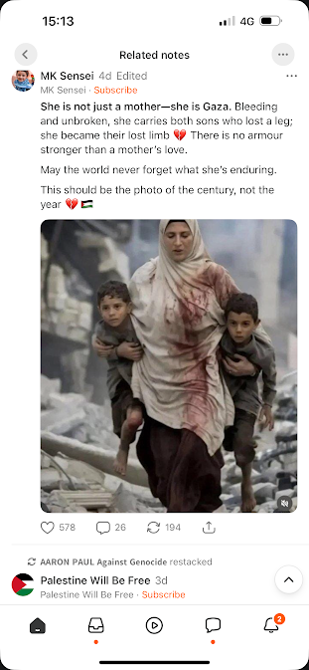

Slide 13
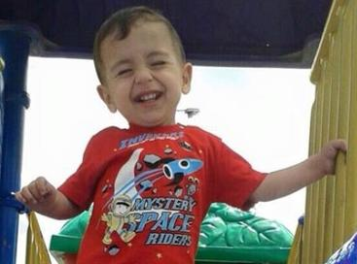
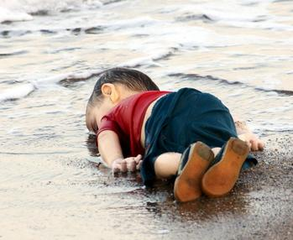
In 2015 their speaker was Abdullah Kurdi, who said:
If a person shuts a door in someone's face, this is very difficult. When a door is opened they no longer feel humiliated. At this time of year I would like to ask you all to think about the pain of fathers, mothers and children who are seeking peace and security. We ask just for a little bit of sympathy from you. Hopefully next year the war will end in Syria and peace will reign all over the world.[75]

Slide 15
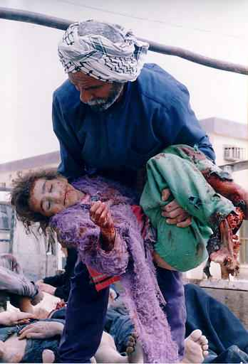

Slide 16
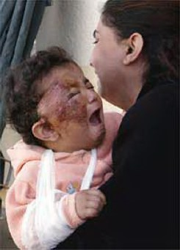

Slide 17
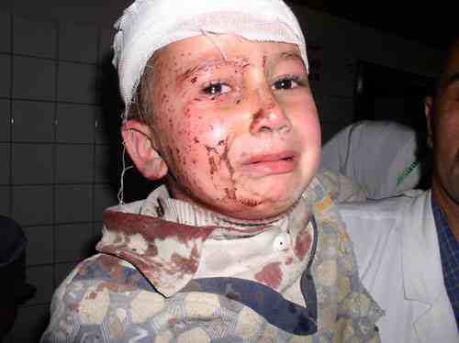

Slide 18
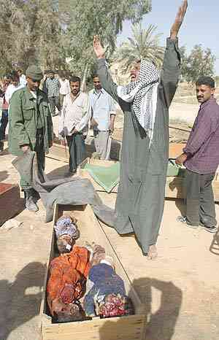

Slide 19
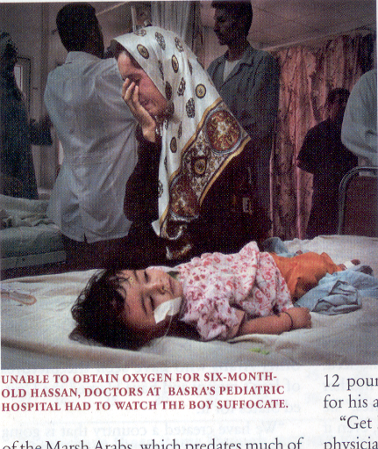
5,000 children die per month in Iraq thanks to “UN” sanctions

Slide 20
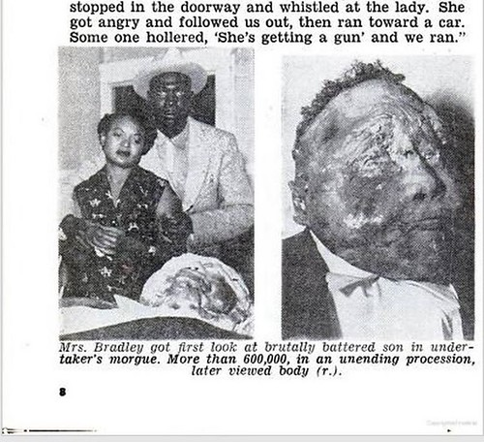
In August 1955, Emmett Till, a black teenager from Chicago, was visiting relatives in Mississippi when he stopped at Bryant’s Grocery and Meat Market. There he encountered Carolyn Bryant, a white woman. Whether Till really flirted with Bryant or whistled at her isn’t known. But what happened four days later is. Bryant’s husband Roy and his half brother, J.W. Milam, seized the 14-year-old from his great-uncle’s house. The pair then beat Till, shot him, and strung barbed wire and a 75-pound metal fan around his neck and dumped the lifeless body in the Tallahatchie River. A white jury quickly acquitted the men, with one juror saying it had taken so long only because they had to break to drink some pop. When Till’s mother Mamie came to identify her son, she told the funeral director, “Let the people see what I’ve seen.” She brought him home to Chicago and insisted on an open casket. Tens of thousands filed past Till’s remains, but it was the publication of the searing funeral image in Jet, with a stoic Mamie gazing at her murdered child’s ravaged body, that forced the world to reckon with the brutality of American racism. For almost a century, African Americans were lynched with regularity and impunity. Now, thanks to a mother’s determination to expose the barbarousness of the crime, the public could no longer pretend to ignore what they couldn’t see.

Slide 21
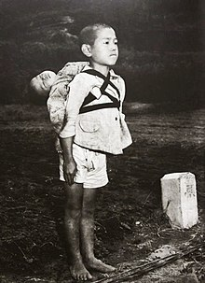
I saw a boy about ten years old walking by. He was carrying a baby on his back... I saw that the baby was already dead. The men held the body by the hands and feet and placed it on the fire. The boy stood there straight without moving, watching the flames. He was biting his lower lip so hard that it shone with blood. The flame burned low like the sun going down. The boy turned around and walked silently away.
— Joe O'Donnell^{[2]}

Slide 24
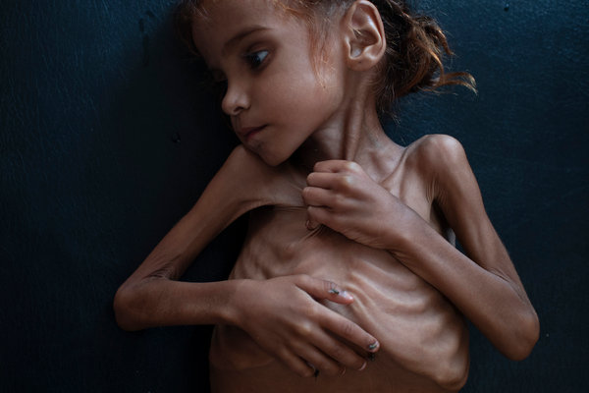
BULLETIN BOARD NTY Oct. 26, 2018
Why We Are Publishing Haunting Photos of Emaciated Yemeni Children
The story of Yemen and all its suffering is one that must be told, and as powerful as Declan’s writing is, it cannot be told in words only.
Yes, Tyler’s images are hard to look at. They are brutal. But they are also brutally honest. They reveal the horror that is Yemen today. You may choose not to look at them. But we thought you should be the ones to decide.

Slide 26
Is there a limit to the depravity, Savagery, Lunacy of “The West” aka “The Rules Based Society or “ The International Community”

Slide 27
“500,000 Iraqi children are already malnourished,and Iraq currently has only 1 months supply of food and 3 months of medicines remaining”
“ Iraq’s 13 million children are at grave risk of starvation, disease and psychological trauma”
“… Possibly hundreds of thousands ofchild deaths and casualities”

Slide 29
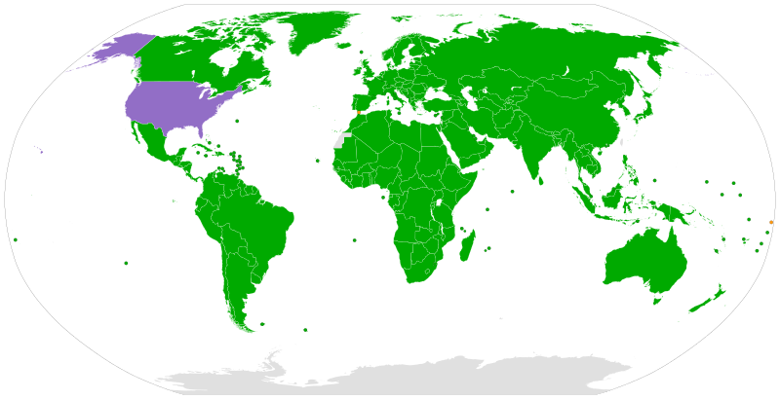
File:Convention on the Rights of the Child.svg

Slide 31
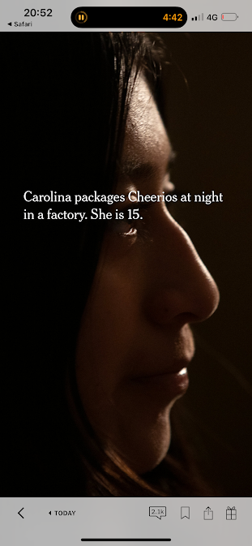
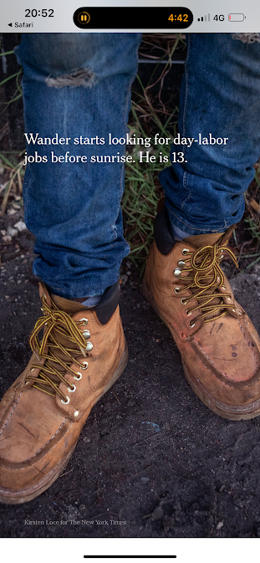

Slide 35
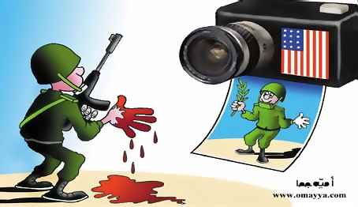
“Without censorship, things can get terribly confused in the public mind.”
— General William Westmoreland United States Army

Slide 36
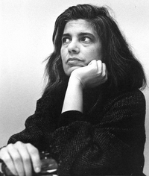
“Mozart, Pascal, Boolean algebra, Shakespeare, parliamentary government, baroque churches, Newton, the emancipation of women, Kant, Balanchine ballets, et al. don’t redeem what this particular civilization has wrought upon the world. The white race is the cancer of human history.”
Susan Sontag

Slide 37
” The greatest Crime since WW2 has been US foreign Policy”
Ramsey Clarke Former US Attorney General

Slide 38
The Children of Gaza… what now?

Slide 39
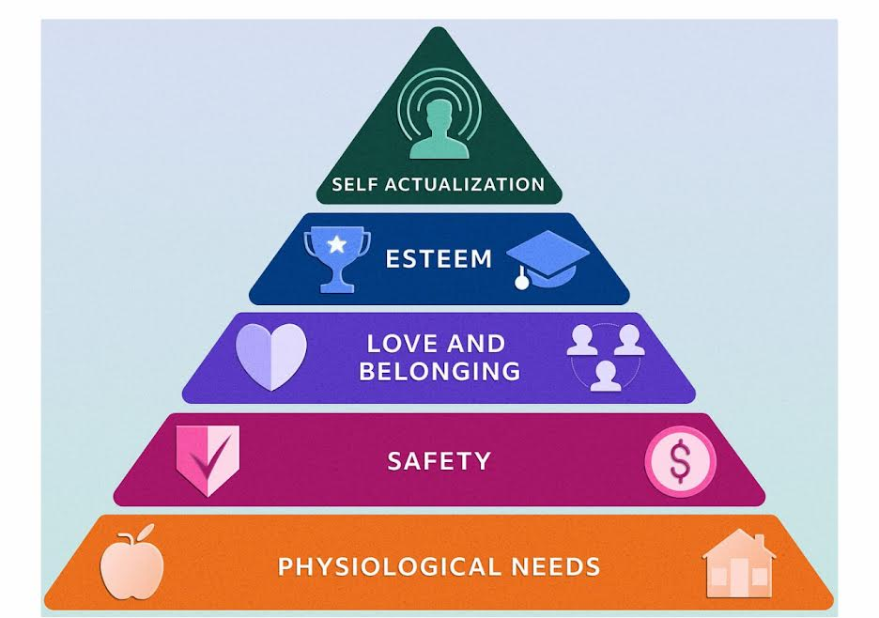

Slide 40
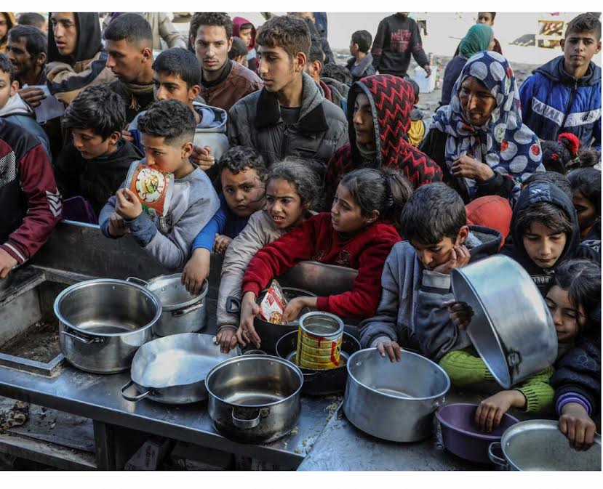
Physiological Needs
Food, Water,Shelter, Power, Sleep and Health
In Gaza ALL have ben detroyed

Slide 41
“ there is no safe place in Gaza”
Antonio Gutteres
Homes ,Schools, Hospitals have been bombed
Children targeted by snipers
Flour massacre
Safety

Slide 42
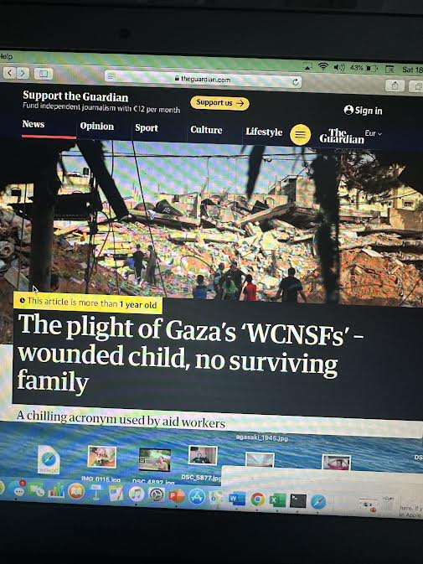
Love and Belonging
10,000 WCNSF
Imagine that lonliness

Slide 43
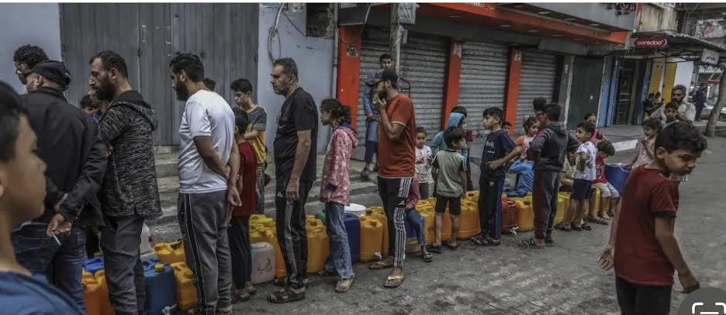
ESTEEM
People stand for hours, barefoot in the rubble waiting for a loaf of bread
Writers Doctors engineers .. Robbed of their profession … beg for aid
Children who once dreamed ofbecoming Artists, Doctors Teachers now only dream of a meal and a safe nights sleep

Slide 44
Self Actualisation
The ability to realise one’s potentia. .. The Teachers , Musicians,Poets, Writers and Athletes have all ben killed
Schools Libraries, Universities have been destroyed.
The future has been evaporated
Palestine ha been deniedthe 3 essentials for Self Actualisation
Stability
Security
Freedom
Israel has intentionally tried to destroy HOPE

Slide 46
§

Slide 48
Compassion involves Helping

Slide 49
OUR GOVERNMNTS
Rules based Society
International Community
Only Democracy in Middle East

Slide 50
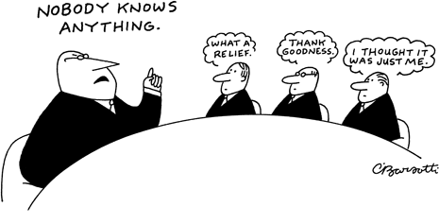
Notes:
50

Slide 51
The Children are the answer…. And their Teachers

Slide 53
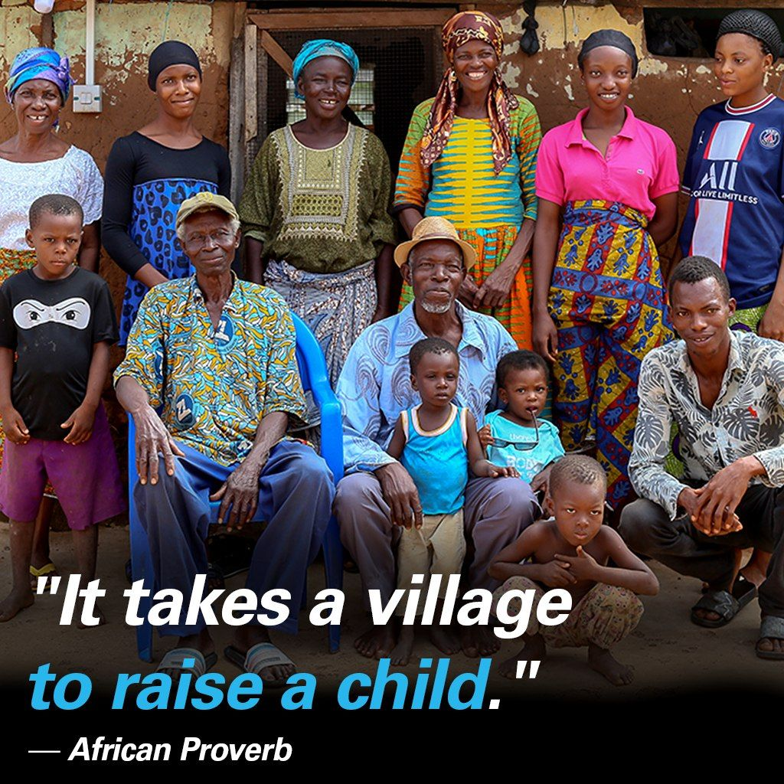

Slide 55
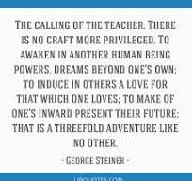
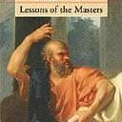

Slide 56
Some of these ‘villagers’ include:
Educators
Immediate and extended family
Friends (your child’s and yours)
Neighbours
Even hairdressers and barbers
We owe it to our children to allow them to experience far more than we ever did as a child and to give them that sense of belonging and community.

Slide 57
”To Teach , to Teach well is to be party to Transcendent possibility… awoken that exacerbating child in the back row, might propose the theorem, or write the lines that will busy centuries’
George Steiner Lessons of the Masters

Slide 58
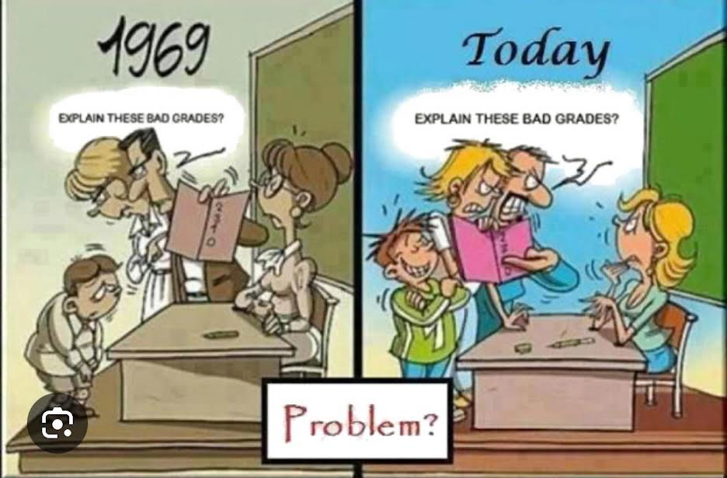

Slide 59
Ken Robinson How education kills creativity

Slide 60
Development

Slide 64
A better World is Possible !

Slide 65
Cuba: 45 years of Progress

